Slide 1

Made with Power BI
Dream Team
By Khalid Atthariq Wiraguna Aseran

Slide 2
Intro
Onyx Data DataDNA – Dataset Challenge is monthly learning and development appointment with yourself and hundreds of passionate data people organized by Onyx Data for free. Every patricipant assigned for create better, more effective data visualizations, analysis and make information more accessible, from given data set.

Slide 3
Analysis Indicator
For july 2022 DataDNA Challenge - Onyx Data assignd us to analyzing pokemon data and make a Pokemon Dream Team based of 6 pokemon that inflict the most damage while remaining relatively impervious to any other pokemon

Slide 4
Data Set
Name: the english name of the pokemon
Japanese_name: the original japanese name of the pokemon
Pokedex_number: the entry number of the pokemon in the national pokedex
Percentage_male: the percentage of the species that are male. Blank if the pokemon is genderless.
Type1: the primary type of the pokemon
Type2: the secondary type of the pokemon
Classification: the classification of the pokemon as described by the sun and moon pokedex
Height_m: height of the pokemon in metres
Weight_kg: the weight of the pokemon in kilograms
Capture_rate: capture rate of the pokemon
Base_egg_steps: the number of steps required to hatch an egg of the pokemon
Abilities: A stringified list of abilities that the pokemon is capable of having
Experience_growth: the experience growth of the pokemon
Base_happiness: base happiness of the pokemon
Against_?: Eighteen features that denote the amount of damage taken against an attack of a particular type
Hp(Hit Point): the base HP of the pokemon
Attack: the base attack of the pokemon
Defense: the base defense of the pokemon
Sp_attack(Special Attack): the base special attack of the pokemon
Sp_defense(Special Defense): the base special defense of the pokemon
Speed: the base speed of the pokemon
Generation: the numbered generation which the pokemon was first introduced
Is_legendary: denotes if the pokemon is legendary

Slide 5
Detail on Stats
HP (Hit Point) - determines how much damage a Pokémon can receive. When a Pokémon's HP is completely down to 0, the Pokémon will faint.
Attack - determines how much damage a Pokémon will cause to the opponent while using a physical move.
Defense - determines how much damage a Pokémon will resist when hit by a physical move.
Special Attack - determines how much damage a Pokémon can cause while using a special move.
Special Defense - determines how much damage a Pokémon will resist when hit by a special move.
Speed - determines which Pokémon will act first during battle

Slide 6
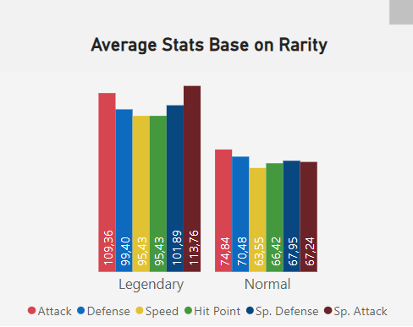
Is Legendary Pokemon Better Then Normal Pokemon?
First analysis – for this Chart you’ll know that legendary pokemon has better avarage stats then normal pokemon. But you can’t always depend on rarity for choosing pokemon for your team so it’s better for you to choose a pokemon that suits for your team

Slide 7
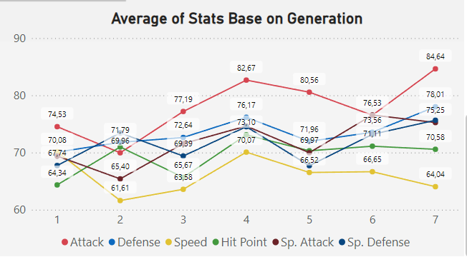
Which Generation has The Better Stats?
Second analysis – From this Line Chart, describe each stats fluktuate for each gen. Here you can see that gen 7 has better attack stats, if you want more balance stats you can consider to choose from gen 4

Slide 8
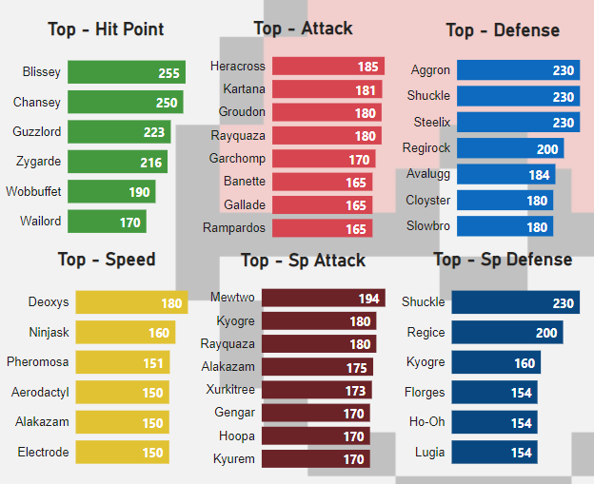
Best Pokemon For Each Stats
Third analysis – in order to make a dream team you must know the best pokemon from each stats. So that you can determine a role for each pokemon, and how you can make better use for every pokemon you choose as the part of your dream team

Slide 9
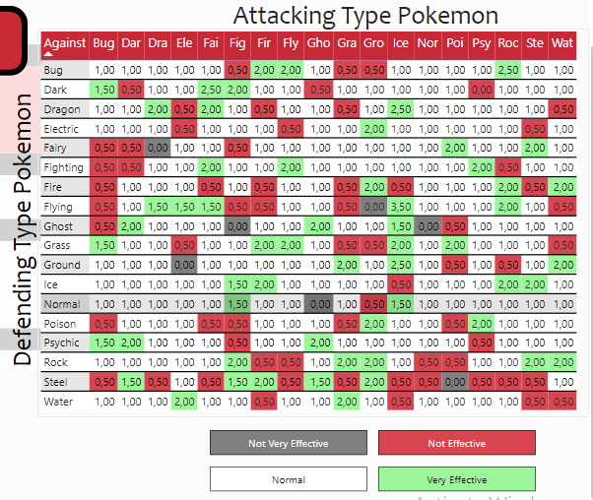
How Can We Choose Pokemon Base on Type?
Forth analysis – not just the stats but you also want to know each type of pokemon. If you want attacker pokemon make sure the pokemon inflict more “very effective” for certain type, but for durable or tank pokemon you must avoid those “very effective” as much as possible. Such as Normal type pokemon has very balance weakness and strength

Slide 10
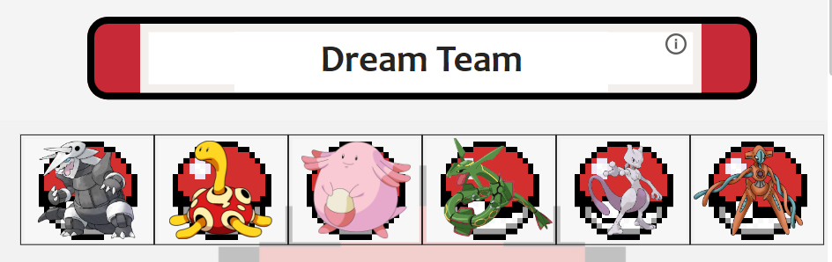

Slide 11
Based on the analysis, here is my dream team from left side i choose Aggron, Shuckle, Blissey, Rayquaza, Mewtwo, Deoxys.
Aggron - tank with high physical damage and physical defense but weak to many type, you can use it first or second pokemon to start a battle
Shuckle - second tank with high physical and special defense, block alot of damage but did not do alot of damage. If you want to go far with shuckle you can always learn every abilitiy suitable for shuckle, especially for rock type has one OP ability based on luck but be wary for flying type
Blissey - is a Normal Type pokemon with high hp and high special defense, but low physical defense and attack. Since this pokemon has netral weakness and strength i would go for tank role, but if you learn the ability you can use it as debuffer role, so you can stale as much as you want and lower enemy stats
Rayquaza - Attacker with daragon flying type would be good for my suggestion. Dragon and flying type has so much advantage in battle even for their own type, and for rayquaza base on stat has very high spec in every stats. So a durable and stong pokemon? Why not!
Mewtwo - Attacker with high special attack and psychic type. for psychic type have very wide oppurtunity for attacker but pay attantion for what pokemon type you facing to, since mewtwo dosen’t have high defense against physical damage and psycich have a certain weakness
Deoxys - deoxys has 4 type in game, the normal form has high speed to out turn opponent pokemon. Other type you can change it to attack form, defense form, speed form, each form has better stats then the other you’ll notice from the name for each form

Slide 12
Conclusion And Suggestion
From the analysis stats and type for every pokemon can be an indicator for building your dream team, its serve enough information for you to determine which pokemon suits for the team. Also the analysis give you information what type you should use for facing your opponent pokemon.
If you want to make your dream team even better, you should learn more for each pokemon ability, how to grind your pokemon stats, how to find pokemon with better effort value(EV) because each pokemon you catch even if its the same pokemon has diffrent EV. The last thing you need to pay attantion for new update or meta for each pokemon series

Slide 13
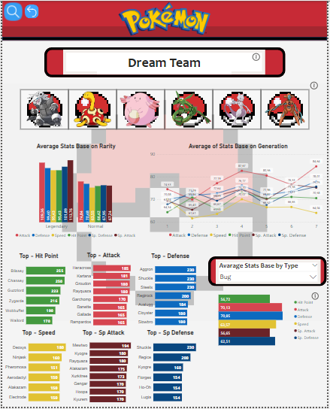
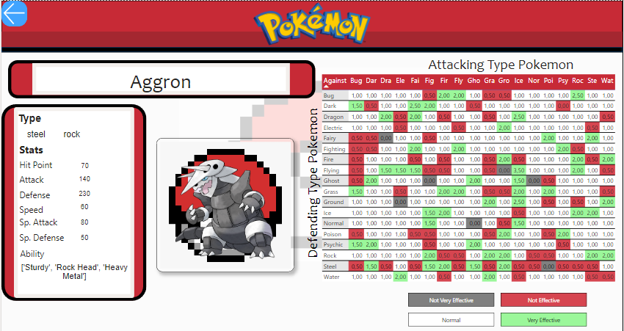
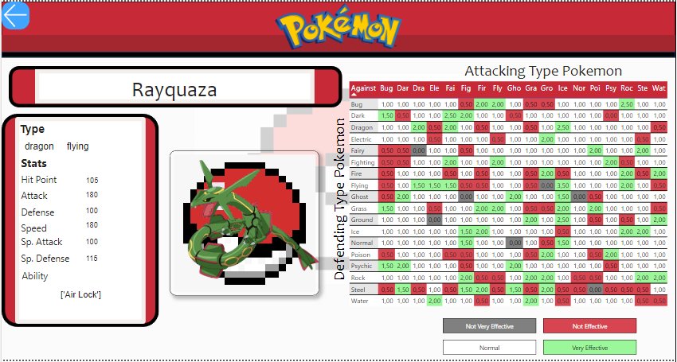
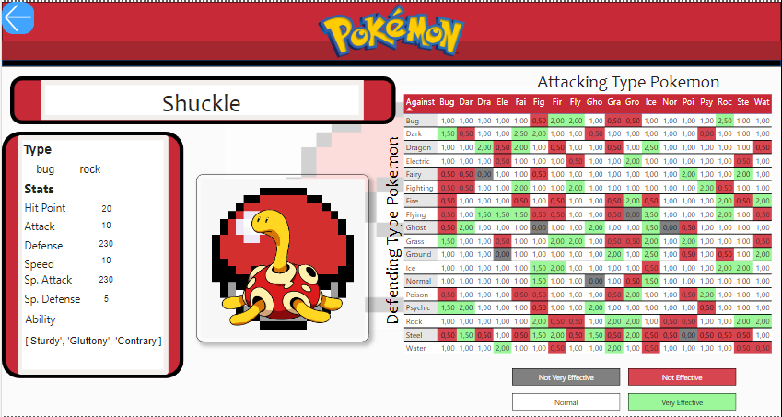
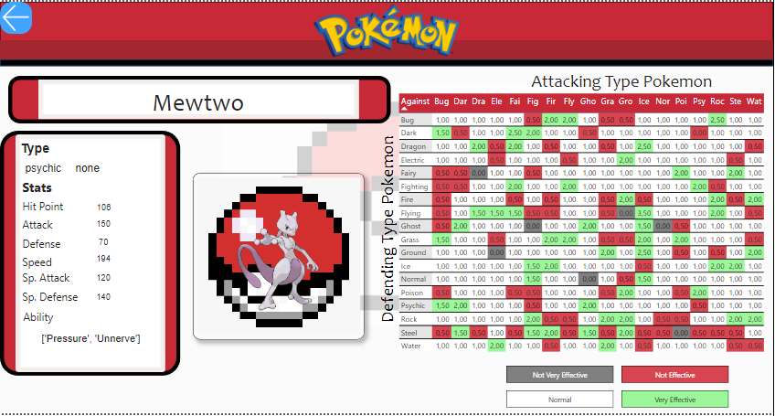
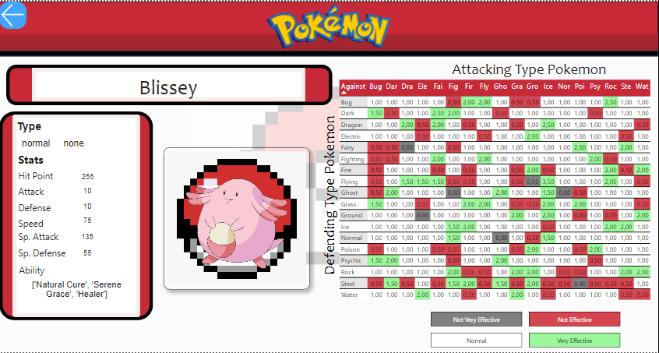
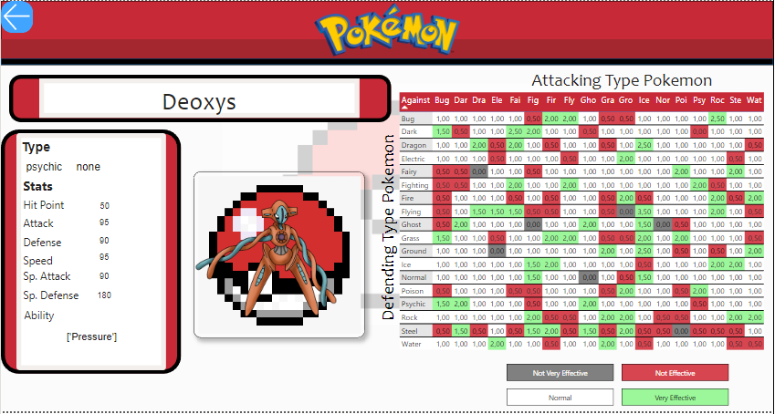
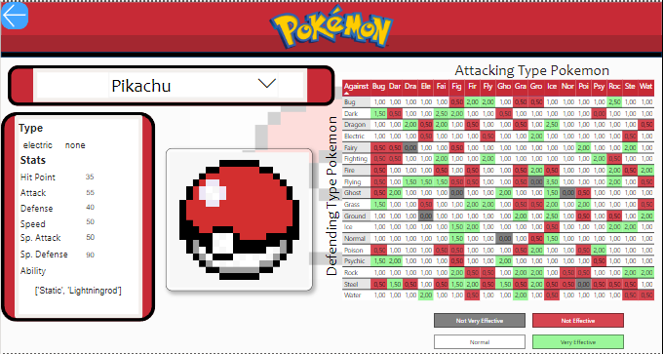

Slide 14
Reference
https://onyxdata.co.uk/dataset_challenge/july-2022/
https://www.kaggle.com/datasets/kartikkadian/pokemondata
https://www.wikihow.com/Create-a-Balanced-Pok%C3%A9mon-Team
https://bulbagarden.net/
https://www.pokemon.com/us/play-pokemon/about/video-game-glossary/

Slide 15
THANK YOU
And hope you can make your own dream team

